Slide 1
Radar Speed Gun Team
Numerical Analysis Project

Slide 2
Team members
Ahmed Khaled Ahmed 2127352
Amin Adel Yousry 2127331
Mostafa salah Mostafa 1827107

Slide 3
Objective
Estimate a speed of a moving object from its position function.
Apply and compare multiple numerical methods for derivative approximation.
Build an interactive GUI for easy use and visualization.

Slide 4
Tools Used
Software: GNU Octave
Programming Language: MATLAB/Octave syntax
Numerical methods:
Euler forward.
Euler backward.
Heun’s method.
Midpoint method.
Rung-Kutta4.
Adams-Bashforth.
Adams-Moulton.

Slide 5
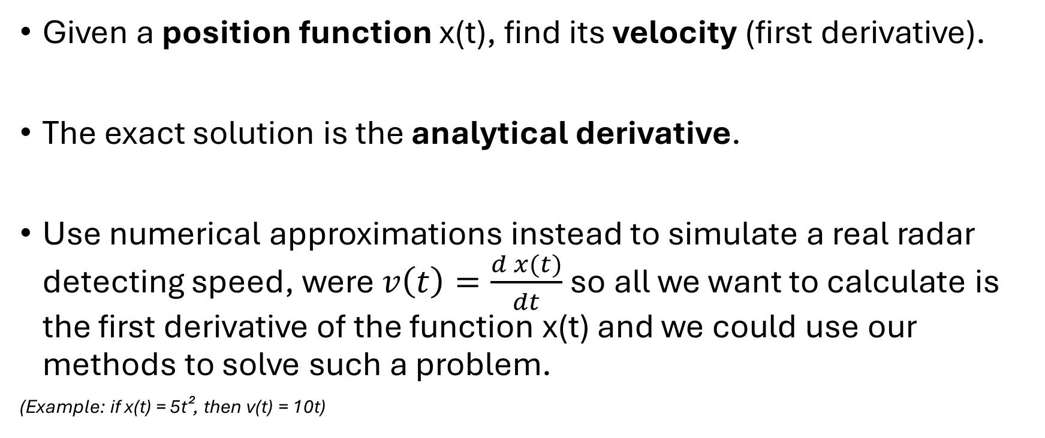
Problem Description
Given a position function x(t), find its velocity (first derivative).
The exact solution is the analytical derivative.
Use numerical approximations instead to simulate a real radar detecting speed, were $v\left(t\right)=\frac{d x(t)}{dt}$ so all we want to calculate is the first derivative of the function x(t) and we could use our methods to solve such a problem.
(Example: if x(t) = 5t², then v(t) = 10t)

Slide 6
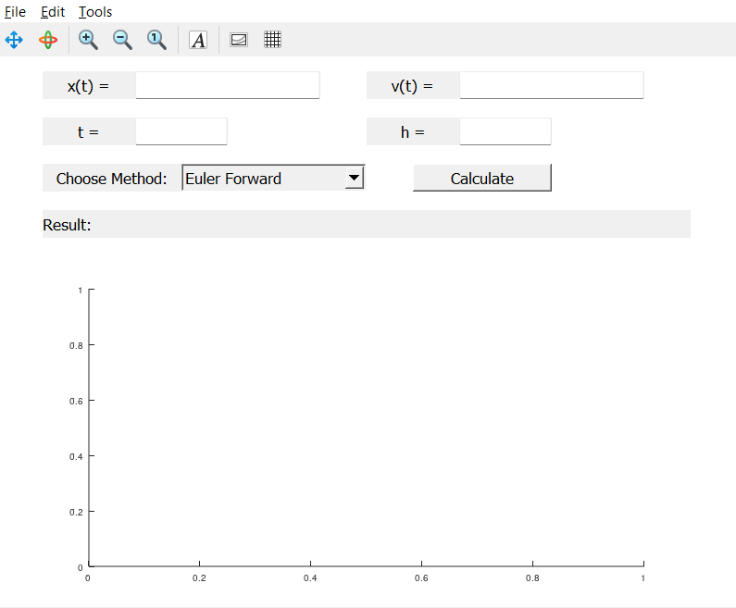
GUI Design
Simple and clean interface.

Slide 7
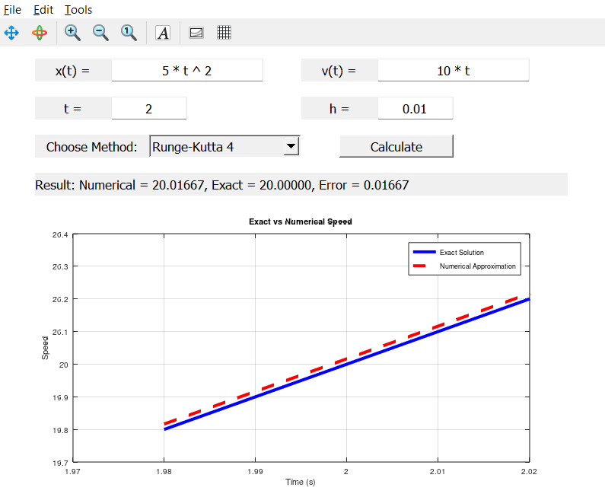
GUI Design
Simple plot showing the difference between the exact sol and numerical sol for the chosen method.

Slide 8
Conclusion
Successfully simulated a radar speed gun.
Numerical methods can approximate derivatives with high accuracy.
RK4 and Adams-Moulton performed best.
GUI makes testing and visualization easy for users.

Slide 9
Thank you

